Slide 1
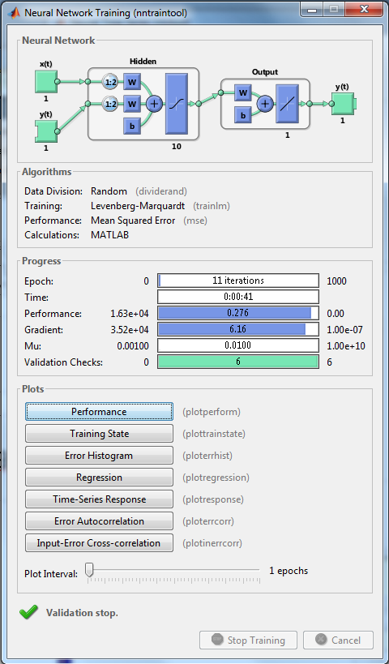
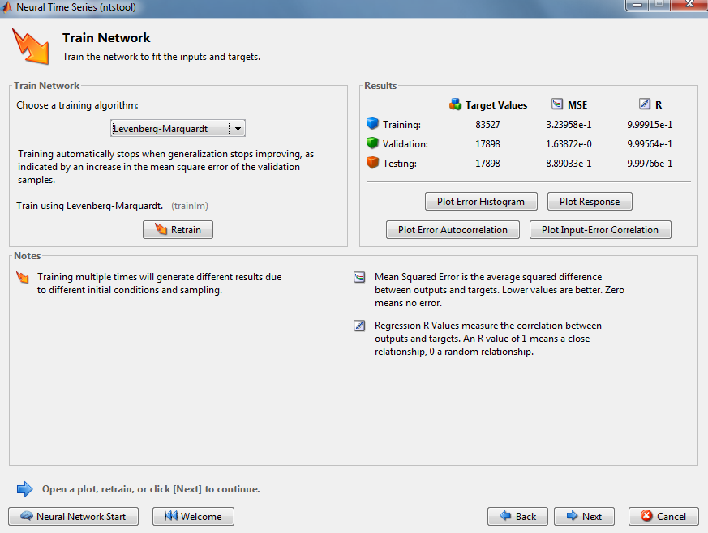
Using Nntraintool in Matlab to train

Slide 3
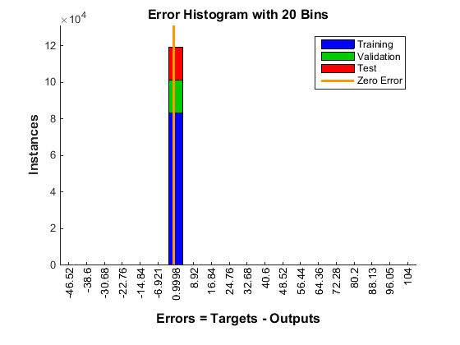
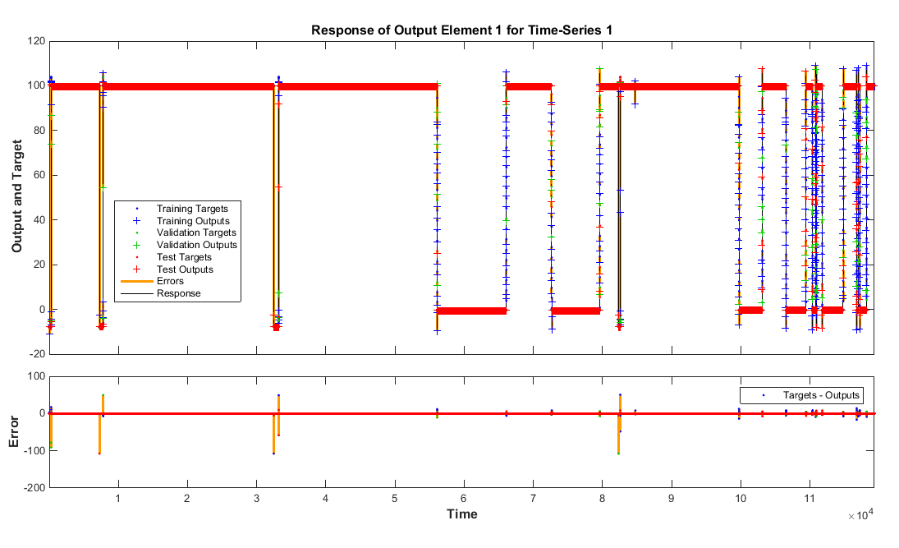
Nonlinear autoregression with external input (NARX)

Slide 4
Reducing some zero data

Slide 5
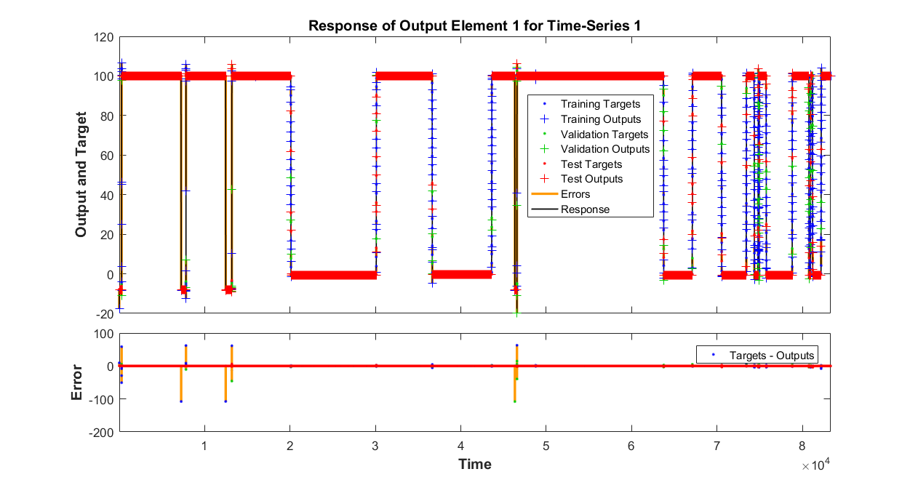

Slide 6
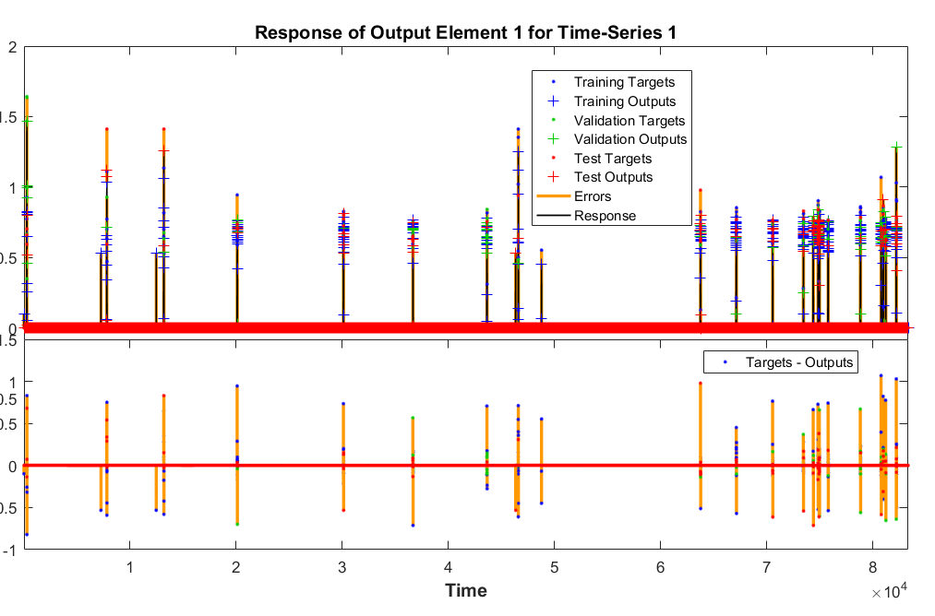
Reverse input/output for training

Slide 7
Training With two input and one target output

Slide 8
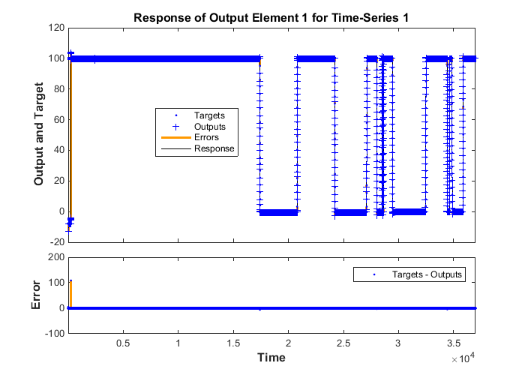
Neural network training response(using only CTF1 run 1 R01 Sta006 as traingin data)

Slide 9
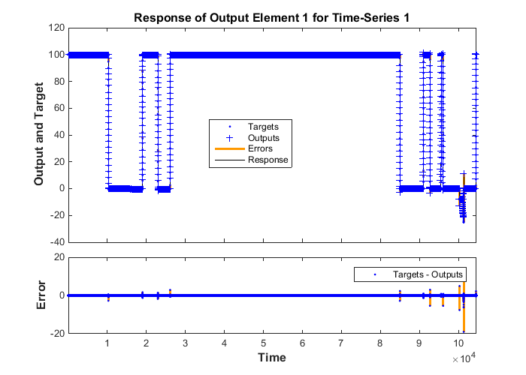
Apply it to testing data( from CTF run 2, sta001,2,6)
Target valve positions

